Slide 1
Eco-Watchdog
system
A Better World Starts with Better Data:We Monitor,You Prosper

Slide 2
— Mahatma Gandhi
“"Earth provides enough to satisfy every man's need, but not every man's greed."

Slide 3
TABLE OF CONTENTS
01
02
03
04
05
Introduction
features
Goals
statistics
conclusion

Slide 4
Our team
Kavya Sharma
Kr ish Monga
Arpit Sharma
Shivansh Mahajan
(Team leader)
Aastha Bhaik

Slide 5
Introduction
The Eco-Watchdog System is an advanced tool for monitoring and protecting the environment.
It utilizes technology like sensors and satellite imagery to track various environmental factors, including air quality, water purity, deforestation, and wildlife preservation.
Through the use of AI and machine learning, it can identify environmental issues and promptly notify the relevant stakeholders.

Slide 6

Features
Effective air quality monitoring
Temperature and humidity measurement
Built-in Wi-Fi connectivity
Suitable for indoor and outdoor areas

Slide 7
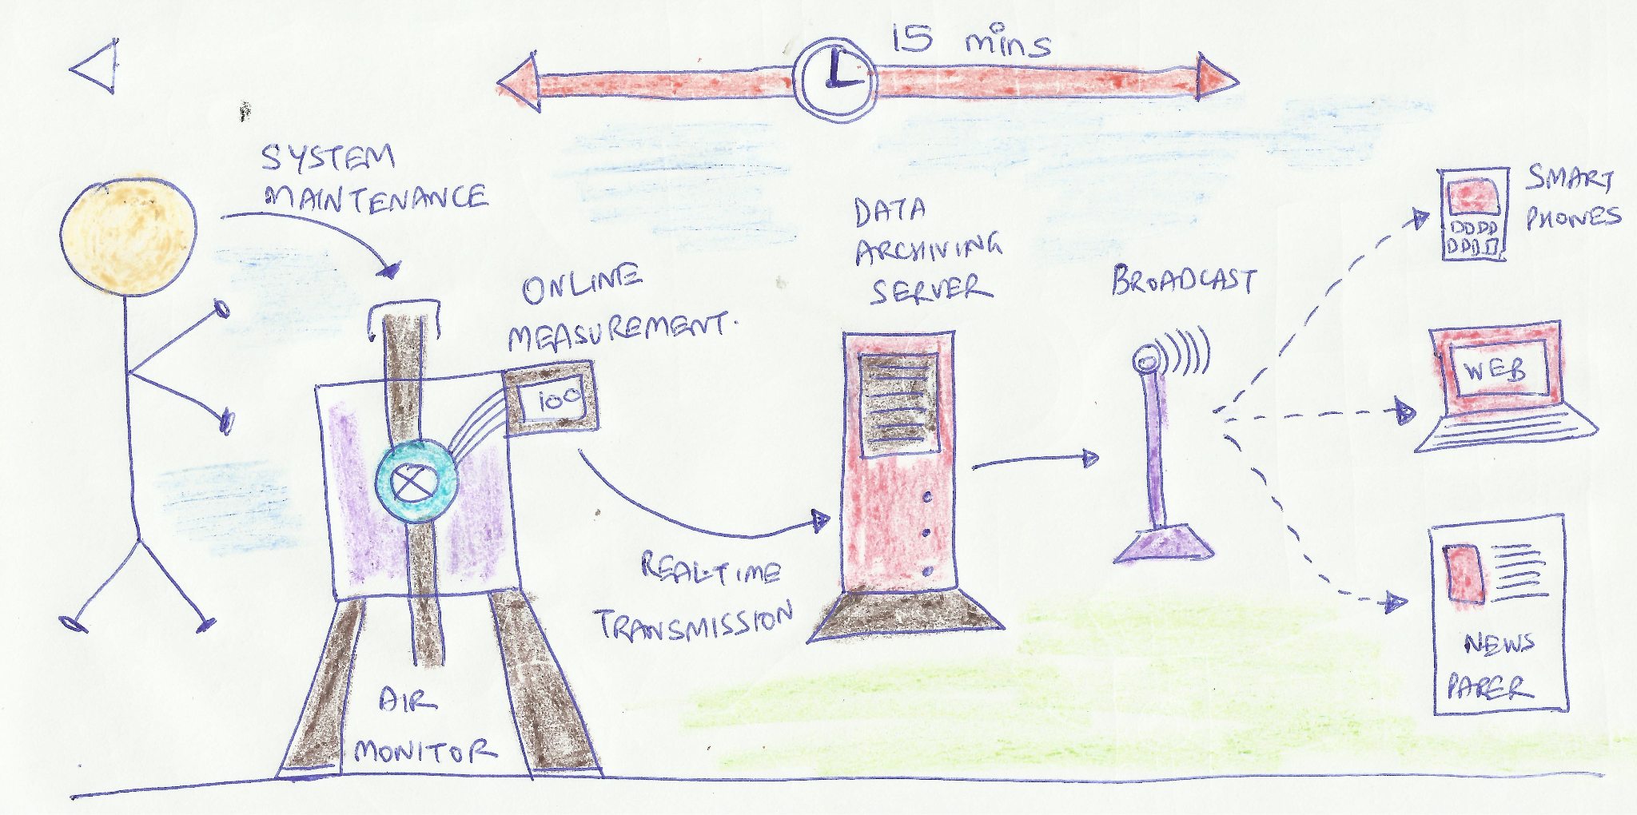
Effective air Quality monitoring
Air quality monitors come equipped with various types of sensors that are designed to detect specific pollutants.
Air quality monitoring is a crucial tool for improving air quality, safeguarding public health, and ensuring regulatory compliance.

Slide 8
Temperature and humidity measurement
Environmental monitoring through IoT involves detecting temperature and humidity using specialized sensors connected to the Internet.
These sensors gather real-time data and transmit it wirelessly to a central system for analysis and monitoring.
The IoT system processes the information and offers insights into temperature and humidity conditions in the monitored area.

Slide 9
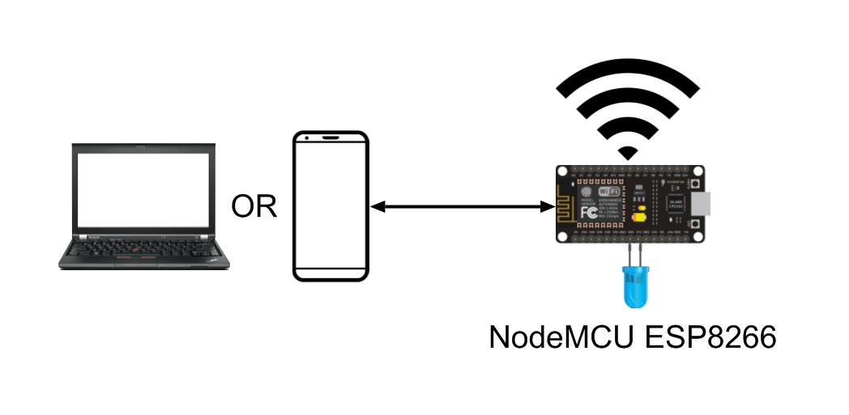
Built-in Wi-Fi connectivity
The integration of built-in WiFi in IoT environmental monitoring offers a variety of benefits, such as wireless data transmission and remote access. This enables real-time monitoring, data collection, energy efficiency, asset protection, regulatory compliance, early warnings, data-driven decisions, and cost savings.

Slide 10
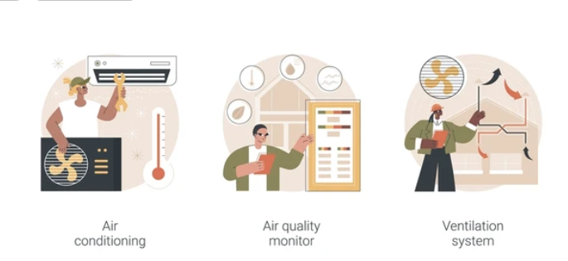
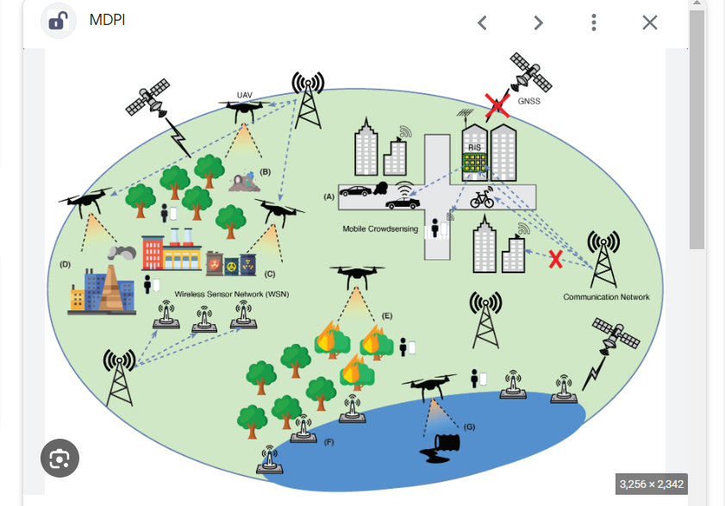
Suitable for indoor and outdoor
Indoor monitoring is well-suited for controlled environments, focusing on aspects like indoor air quality and asset protection.
outdoor monitoring is essential for tracking air quality, weather conditions, and environmental changes in open-air settings.

Slide 11
Goals
Enhance understanding and management of the natural world.
Provide real-time data on environmental parameters.
Data analysis and predictive modeling for identifying long-term environmental trends.
Encouraging innovation in IoT sensor technologies and protocols.

Slide 12
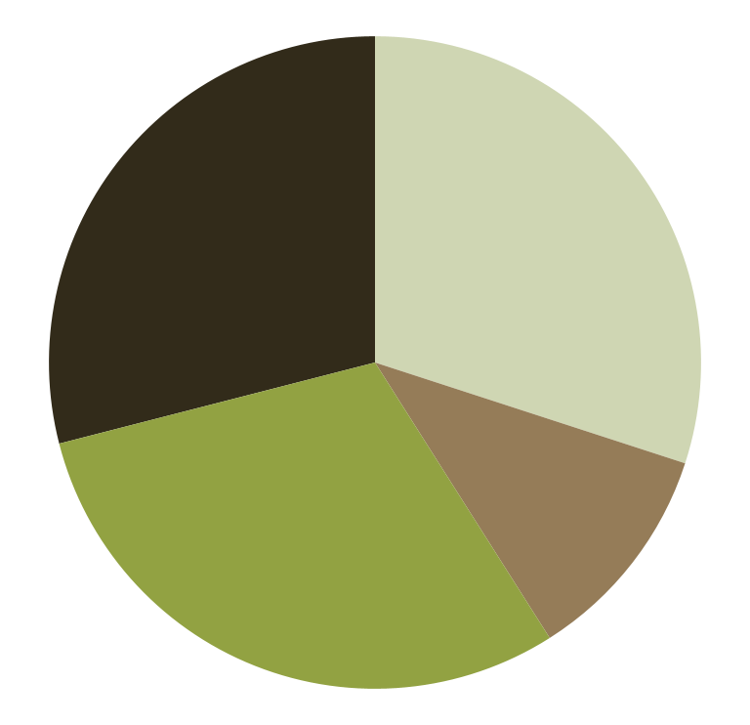
Sources of Greenhouse Gas Emissions
30%
30%
Industry
Commercial and residential
29%
11%
Transport
Agriculture

Slide 13

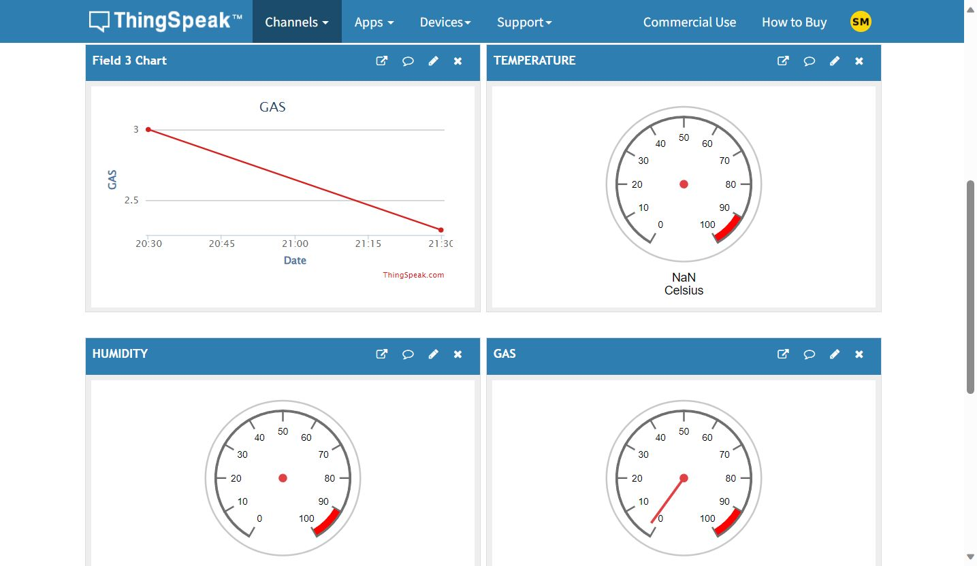
Browser snapshot

Slide 14

Conclusions
Environmental monitoring through IoT involves detecting temperature and humidity using specialized sensors connected to the Internet.
These sensors gather real-time data and transmit it wirelessly to a central system for analysis and monitoring.
The IoT system processes the information and offers insights into temperature and humidity conditions in the monitored area.

